Slide 1
ITEC 101 FUNDAMENTALS OF IT
DANIEL OBUOBI, DCSIT,CU
BASIC COMPONENTS OF A COMPUTER

Slide 2
Data vs. Information
Data vs. Information:
Data is a representation of a fact or idea
Number
Word
Picture
Sound
Information is data that has been organized or presented in a meaningful fashion.
Notes:
Strictly defined, a computer is a data processing device that performs four major functions:
1. It gathers data (or allows users to input data).
2. It processes that data into information.
3. It outputs data or information.
4. It stores data and information.

Slide 3
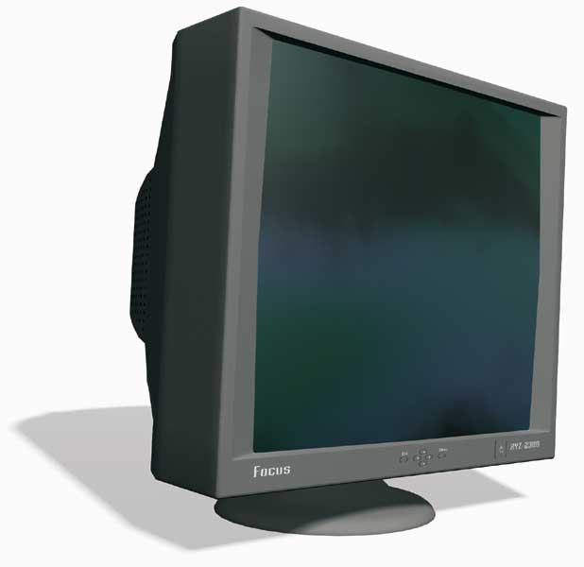
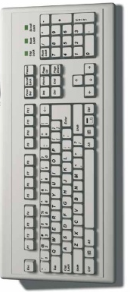
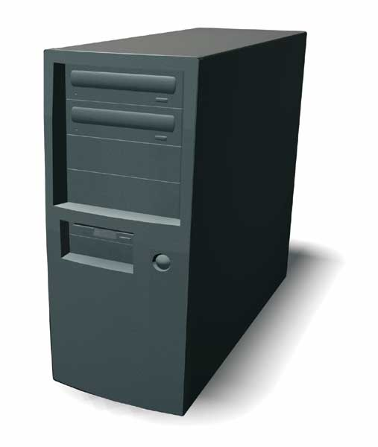
Computers are Data Processing Devices
Four major functions:
Input data
Process data
Output information
Store data and information
DATA IN
INFORMATION OUT
Notes:
Strictly defined, a computer is a data processing device that performs four major functions:
1. It gathers data (or allows users to input data).
2. It processes that data into information.
3. It outputs data or information.
4. It stores data and information.

Slide 4
Bits and Bytes: The Language of Computers
Bit
Binary digit
0 or 1
Byte
Eight bits
ASCII
Each byte represents a letter, number or special character
Microchip Switch
OFF
ON
0
1
= 4
0
0
1
1
0
1
0
0
= A
0
1
0
0
0
0
0
1
Notes:
In order to process data into information, computers need to work in a language they understand. This language, called binary language, consists of just two digits: 0 and 1.
Everything a computer does is broken down into a series of 0s and 1s. Each 0 and 1 is a binary digit, or bit for short.
Eight binary digits (or bits) combine to create 1 byte.
In computers, each letter of the alphabet, each number, and each special character (such as the @ sign) consists of a unique combination of 8 bits, or a string of eight 0s and 1s.
As it turns out, if 8 bits are put together there are 256 possible combinations that they can be in. That number of combinations allows for a code that can include all the upper and lower cases of the alphabet, all 10 digits, punctuation and a number of other much-used symbols. We call these 8 bits working together a byte. Bytes are the basic measurement for storage in a computer.

Slide 5
How Much is a Byte?
NAME | ABBREVIATION | NUMBER OF BYTES | RELATIVE SIZE
Byte | B | 1 byte | Can hold one character of data.
Kilobyte | KB | 1,024 bytes | Can hold 1,024 characters or about half of a typewritten page double-spaced.
Megabyte | MB | 1,048,576 bytes | A floppy disk holds approximately 1.4 MB of data, or approximately 768 pages of typed text.
Gigabyte | GB | 1,073,741,824 bytes | Approximately 786,432 pages of text. Since 500 sheets of paper is approximately 2 inches, this represents a stack of paper 262 feet high.
Terabyte | TB | 1,099,511,627,776 bytes | This represents a stack of typewritten pages almost 51 miles high.
Petabyte | PB | 1,125,899,906,842,624 bytes | The stack of pages is now 52,000 miles high, or about one-fourth the distance from the Earth to the moon.
Notes:
Not only are bits and bytes used as the language that tells the computer what to do, they are also what the computer uses to represent the data and information it inputs and outputs.
Kilobytes, megabytes, and gigabytes are therefore simply amounts of bytes.

Slide 6
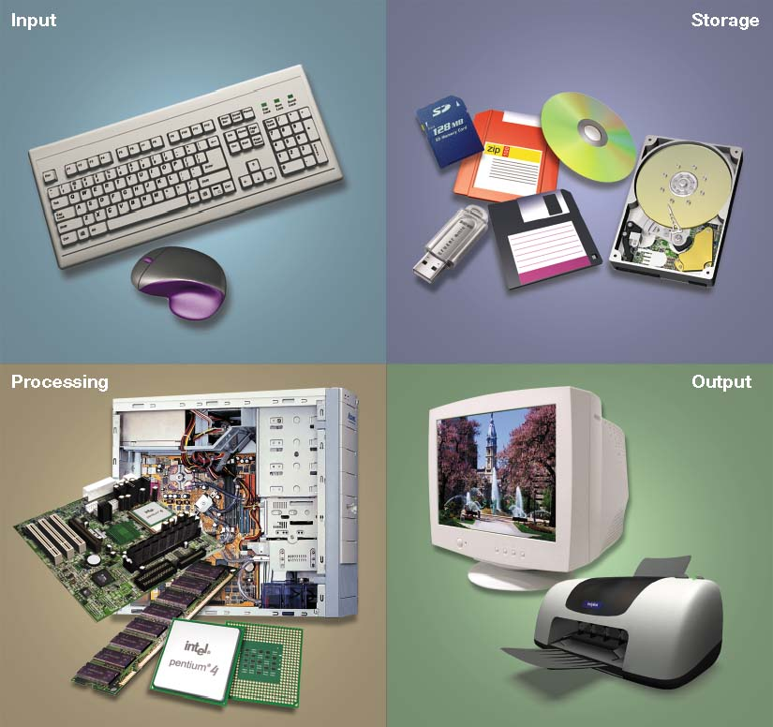
Computer Hardware
Input devices
System unit
Output devices
Storage devices
Notes:
Computer hardware consists of all the real stuff a computer is made of. If you can drop it on the floor, it is hardware.
Hardware devices include input devices like keyboards, components in the system unit like microprocessors, output devices like monitors, and storage devices like a hard drive

Slide 7
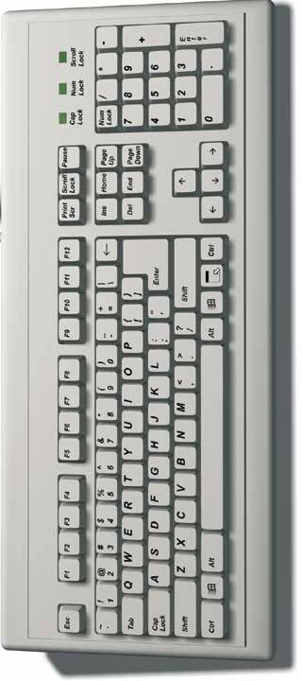
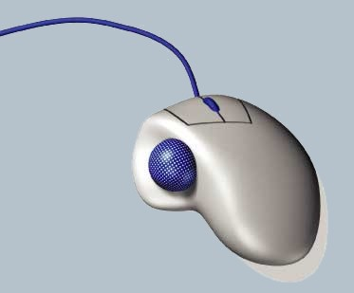
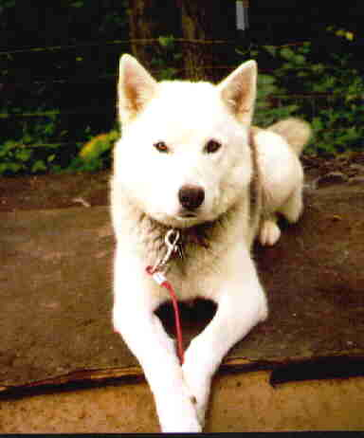
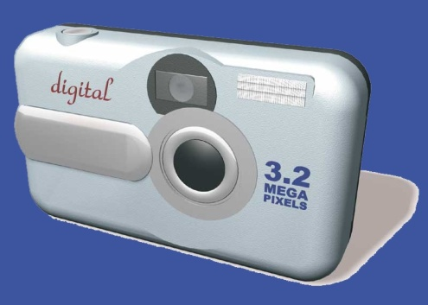
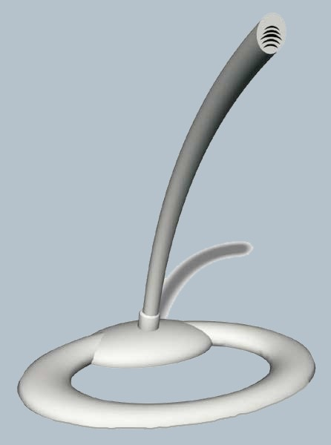
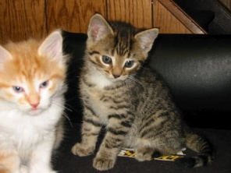
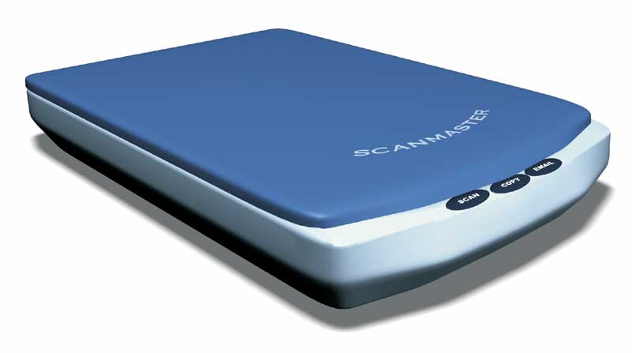
Input Devices
Enter data to be processed
Keyboard
Scanners
Mouse
Trackball
Touch screen
Microphone
Game Controller
Digital camera
A
B
C
D
The rain in Spain
Notes:
Input devices include keyboards and mice, but also scanners, cameras, microphones ,and even network cards and modems. Data that gets into the computer must come through an input device..

Slide 8
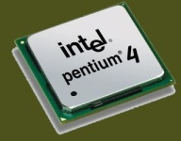
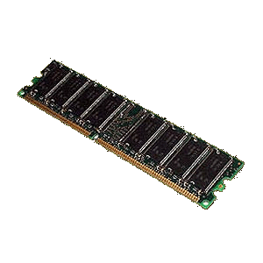
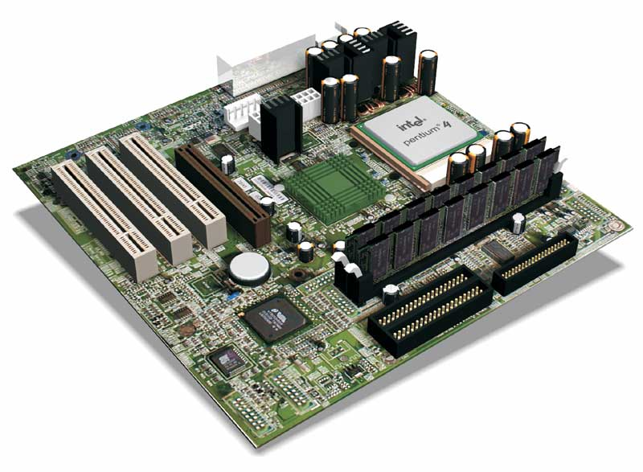
System Unit
Cabinet that houses all components
Motherboard
CPU
Memory modules
System Unit
CPU
Memory Module
Motherboard
Notes:
Once data is entered into a computer, the computer processes that data.
Those components that process data are located inside the system unit. The system unit is the metal or plastic case that holds all the physical parts of the computer together. The part of the system unit that is responsible for the processing is called the CPU.
Memory chips hold (or store) the instructions or data that the CPU processes.
The CPU and memory are located on a special circuit board in the system unit called the motherboard

Slide 9
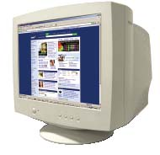
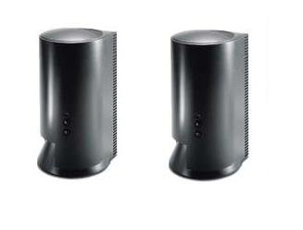
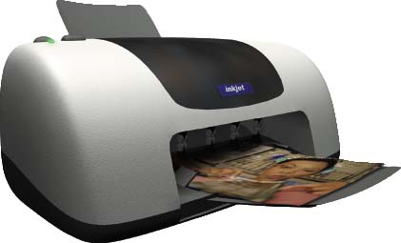
Output Devices
Enable us to see or hear the processed information
Monitor
Speakers
Printers
Notes:
In addition to input devices and the system unit, a computer includes output devices that let you see your processed information. The monitor displays information temporarily, while a printer makes the output permanent. Audio output is through speakers.

Slide 10
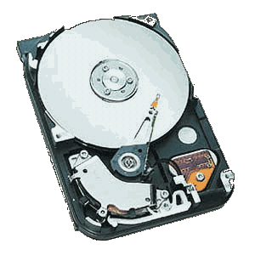
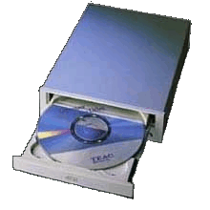

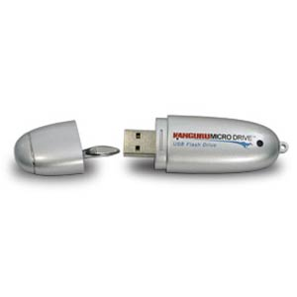
Storage Devices
Enable us to store data or information to be accessed again
Hard Disk Drive
Floppy Disk
CD / DVD Drive
Flash Drive
Notes:
Finally, when your data has been input, processed, and output, you may want to store the data or information so that you can access and use it again.
Specialized storage devices such as hard disk drives, floppy disk drives, flash drives, and CD drives allow you to store your data and information..

Slide 11
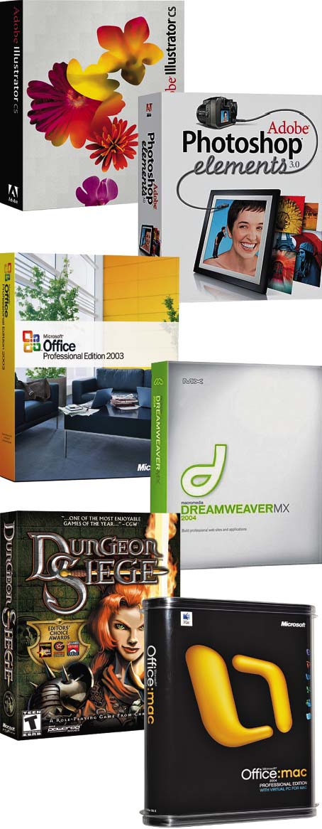
Computer Software
Software - programs that enable the hardware to perform different tasks
Application software
Tools for getting things done
Notes:
Software is the set of computer programs that enables the hardware to perform different tasks. There are two broad categories of software: application software and system software.
Application software actually performs the tasks that users desire.

Slide 12


Computer Software
System software
Essential for platform operation and support
Notes:
System software works to control and maintain the hardware and give the user access to resources.

Slide 13
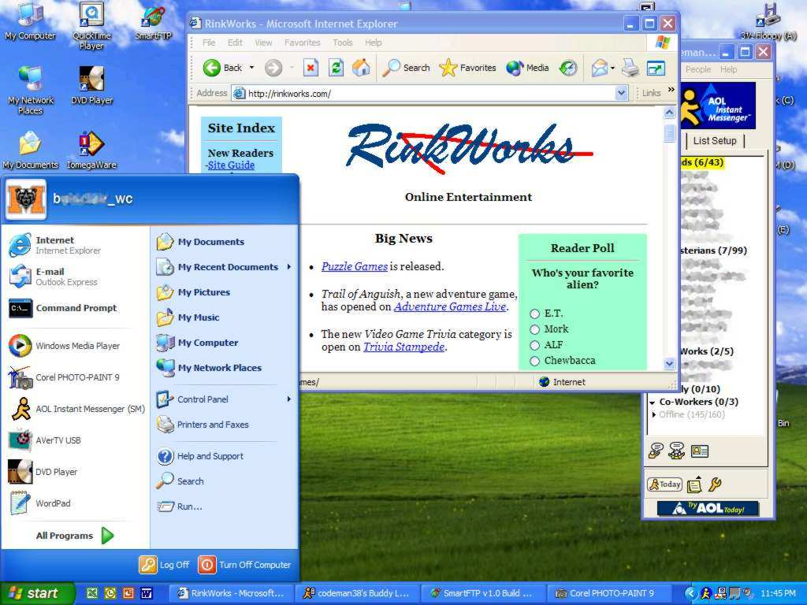
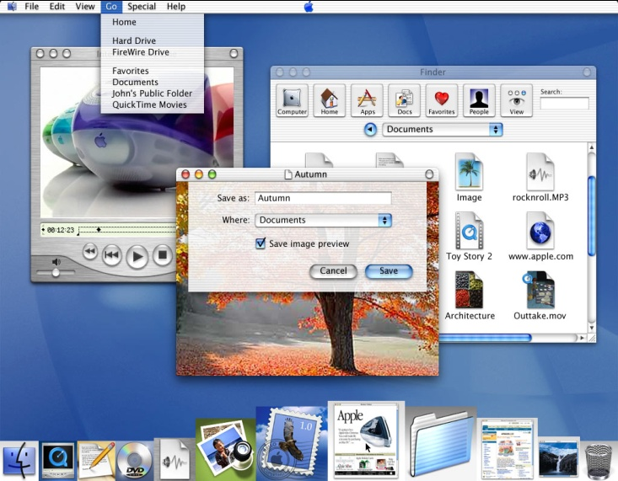
Computer Platforms: PCs and Macs
PC
CPU – Intel, AMD
Operating system – Microsoft Windows
Mac
CPU – Motorola
Operating system – Apple Mac OS
Notes:
The kind of OS you have depends on your computer’s platform. The two most common platform types are the PC and the Apple Macintosh (or Mac).
A platform represents both the base hardware and software that programs must run on and devices must run with. The most used is the Intel-Microsoft platform. The closest competitor in the personal computer field is the Apple-Motorola platform. These platforms have evolved over 25 years and are still competing today. Recently, however, Apple has designed an operating system that works with Intel.

Slide 14
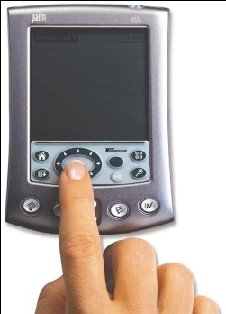
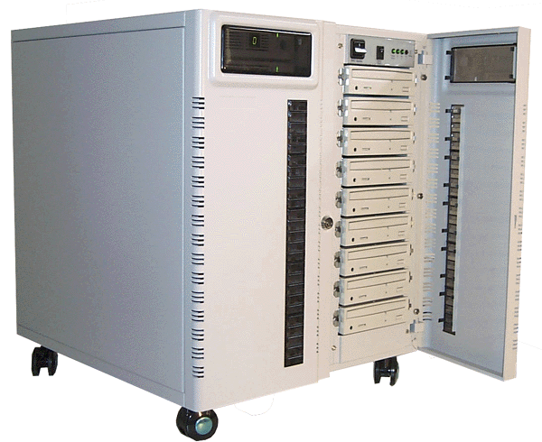
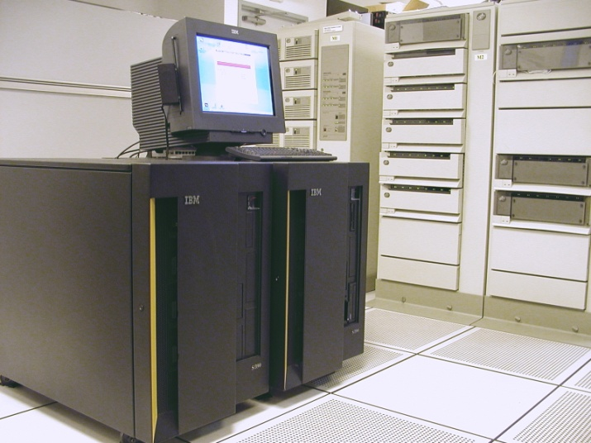
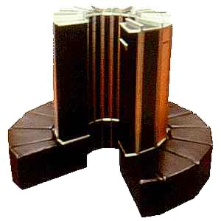
Specialty Computers
PDA
Server
PDA
Server
Mainframe
Supercomputer
Microcontrollers
Mainframe
Supercomputer
Notes:
PDAs are small, one task at a time computers, that serve highly mobile users.
Servers are powerful computers that control networks and often use Unix as an operating system.
Mainframes are large, expensive multifaceted computers designed to handle thousands of users.
Supercomputers are large, fast computers assigned to concentrate on specific scientific tasks.
Embedded computers are specially designed computer chips that reside inside other devices such as your car or your electronic thermostat in your home.

Slide 15
BASIC COMPONENTS

Slide 16
Topics
Hardware components
Input devices
Output devices
System unit
Ergonomics
Notes:
Topics covered in Chapter 2 are:
Hardware components
Input devices
Output devices
System unit
Ergonomics

Slide 17
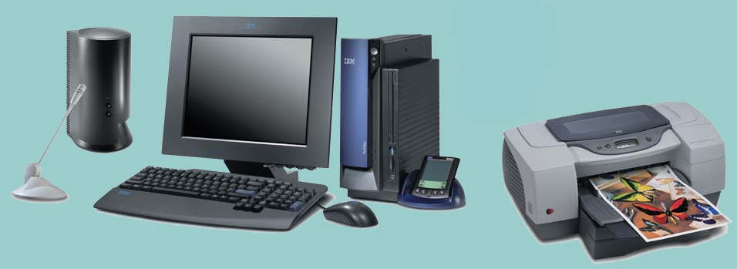
Hardware
System Unit
Peripheral Devices
System Unit
Peripheral Devices
Notes:
Hardware components consist of the >system unit and peripheral devices, those devices such as monitors and printers that are connected to the computer.
Other hardware devices, such as routers, help a computer communicate with other computers to facilitate sharing documents and other resources.
Together the system unit and peripheral devices perform four main functions: they enable the computer to input data, process that data, and output and store the data and information.

Slide 18
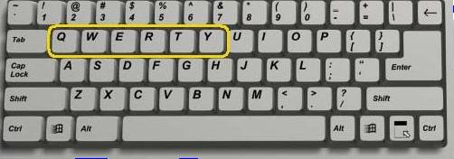
Input Devices
Devices used to enter information or instructions into the computer
Keyboard
Mouse / pointing device
Microphone
Scanner
Digital camera
Notes:
An input device enables you to enter data (text, images, and sounds) and instructions (user responses and commands) into the computer.
The most common input devices are the keyboard and the mouse.
You use keyboards to enter typed data and commands, whereas you use the mouse to enter user responses and commands by clicking on an icon.
There are other input devices as well: microphones input sounds, scanners and digital cameras input non-digital text and digital images.

Slide 19
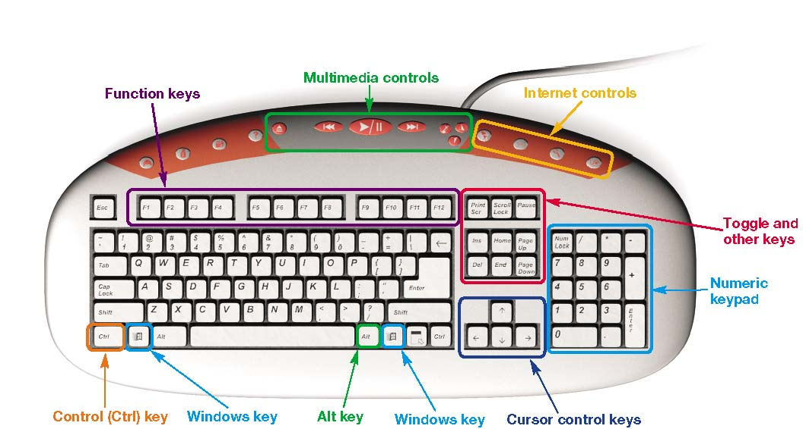
Keyboard
The QWERTY keyboard with enhanced features is standard with most modern personal computers
Notes:
The QWERTY keyboard gets its name from the first six letters in the top-left row of alphabetic keys on the keyboard.
The QWERTY layout was originally designed for typewriters, not computers, and was meant to slow typists to prevent typewriter keys from jamming. The QWERTY layout is therefore considered inefficient because it slows typing speeds.
Now that technology can keep up with faster typing, other keyboards are being considered.

Slide 20
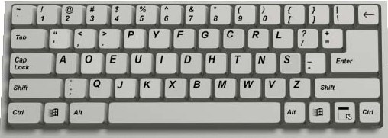
Dvorak Keyboard
Puts the most commonly used keys at “home keys”
Reduces distance of finger stretches
Notes:
With a Dvorak keyboard you can type most of the more commonly used words in the English language with the letters found around the “home keys”, the keys in the middle row of the keyboard.

Slide 21
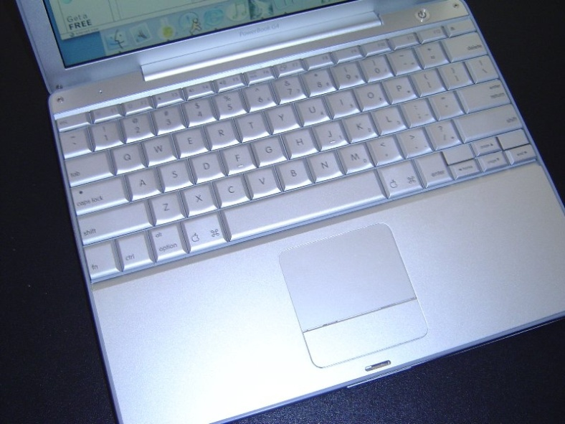
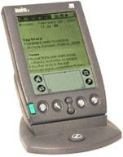
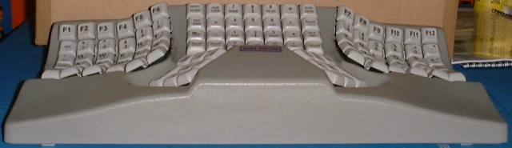
Specialty Keyboards
Laptops
PDAs
Wireless
Ergonomic
Laptop
PDA
Ergonomic
Notes:
Laptop keyboards obviously need to be more compact than standard keyboards and therefore have fewer keys. Still, a lot of the laptop keys have alternate functions so that you can get the same capabilities from the limited keys. You can also hook up traditional keyboards to most laptops, or you can use a specially designed keyboard that fits on top of the laptop.
Generally, you enter data and commands into a PDA by using a stylus, a pen-shaped device that you use by tapping or writing on the PDA’s touch-sensitive screen. However, some PDAs have built-in keyboards that allow you to type in text just as you would with a normal keyboard. If
A wireless keyboard is powered by batteries and sends data to the computer using a form of wireless technology.

Slide 22
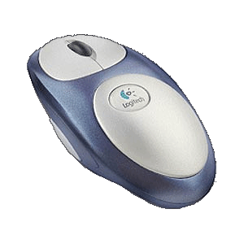
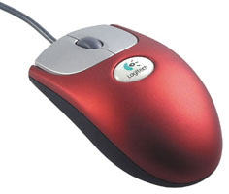
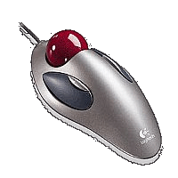
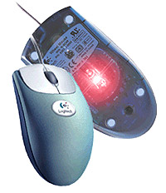
Mouse
Roller ball mouse
Less expensive
Harder to keep clean
Trackball
Harder to control
Stationary on desk
Optical mouse
Needs no mouse pad
Doesn’t need cleaning
More expensive
Standard
Wireless
Trackball
Optical
Notes:
The standard mouse has a rollerball on the bottom, which moves when you drag the mouse across a mousepad.
A trackball mouse remains stationary and doesn’t demand much wrist motion, so it’s considered healthier on the wrists.
The optical mouse uses an internal sensor or laser to detect the mouse’s movement. Optical mice are often a bit more expensive than traditional mice, but because they have no moving parts on the bottom, there is no way for dirt to interfere with the mechanisms and less chance of parts breaking down.
Wireless mice send data to the computer by radio or light waves.

Slide 23
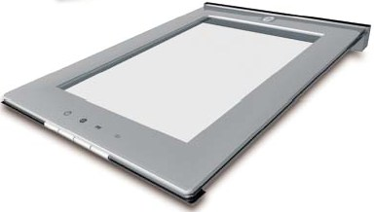
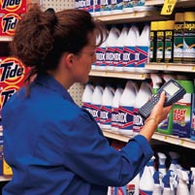

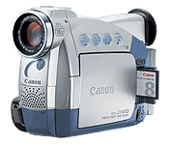
Other Input Devices
Handheld
Scanners
Text
Images
Digital cameras
Images
Video
Flatbed
Camera
Camcorder
Notes:
Other important input devices include scanners and cameras. Scanners copy images from existing sources like book pages or printed copies, digitizing them, and making them available for editing or processing in the computer as well as viewing on the screen.
Digital cameras take pictures and make a digital file of the image for editing, printing ,or distribution on the Web. Digital movies can be created with a digital video camera and edited and distributed electronically
Image files are inputted through a USB or FireWire connection.

Slide 24
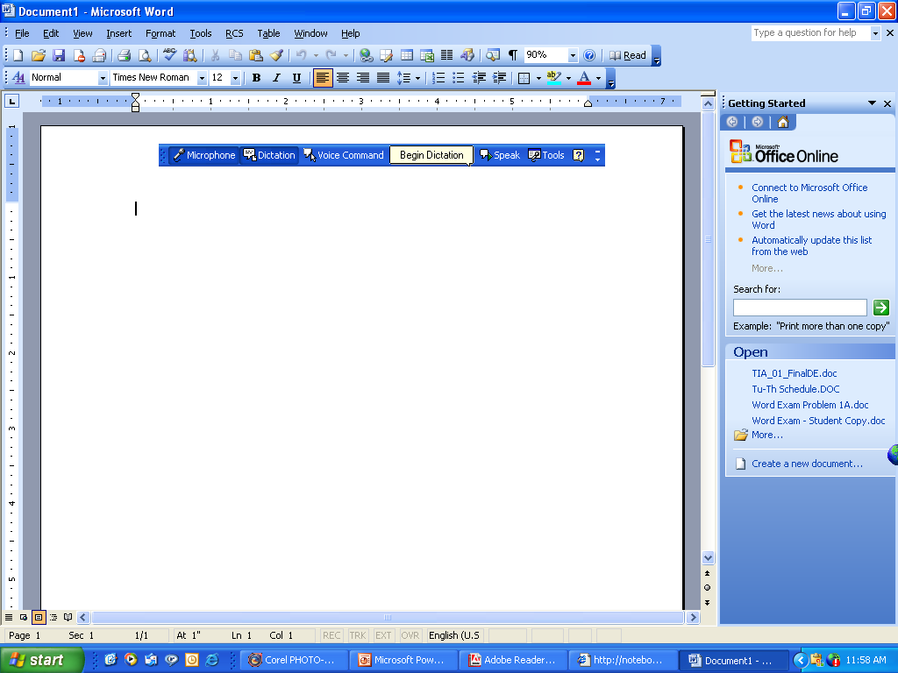
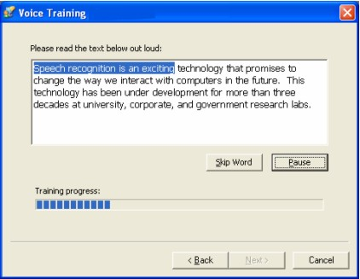
Inputting Sound
Microphone Input
Teleconferencing
Voice over Internet
Voice Recognition
Microsoft Voice Recognition
Notes:
A microphone allows you to capture sound waves (such as your voice) and transfer them to digital format on your computer.
Microphones come with most computers, but if you didn’t get a microphone with your computer, you may want to buy a desktop microphone if you plan to record your own audio files.
A headset microphone is best for videoconferencing and speech-recognition uses. Videoconferencing technology allows a person sitting at a computer equipped with a personal video camera and a microphone to transmit video and audio across the Internet (or other communications medium).
In speech-recognition systems, you operate your computer through a microphone, telling it to perform specific commands or to translate your spoken words into data input.

Slide 25
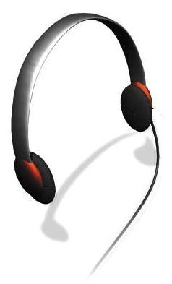
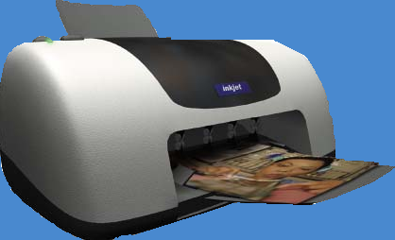
Output Devices
Retrieving information from the computer
Output devices
Softcopy (video, sounds, control signals)
Hardcopy (print)
Notes:
Output devices enable you to send processed data out of your computer. This can take the form of text, pictures (graphics), sounds (audio), and video.
One common output device is a monitor, which displays text, graphics, and video as soft copies (copies you can see only on-screen).
Another common output device is the printer, which creates tangible or hard copies of text and graphics.
Speakers are obviously the output devices for sound.

Slide 26
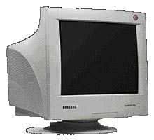
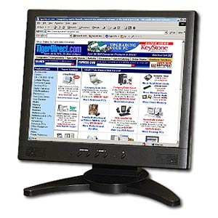
Monitor Types
CRT Cathode Ray Tube
Less Expensive
Use much more space
Uses more energy
Better viewing angles
LCD Liquid Crystal Display
More expensive
Uses far less space
More energy efficient
Less viewable from an angle
Notes:
There are two basic types of monitors: CRTs and LCDs.
If your monitor looks like a traditional TV set, it has a picture tube device called a cathode-ray tube (CRT).
If your monitor is flat, such as those found in laptops, it’s using liquid crystal display (LCD) technology.

Slide 27
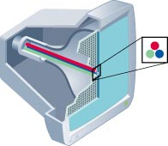
CRT Monitors
Uses picture tube technology
Screen size – Diagonal measurement of the screen (15, 17, 19, 21)
Resolution – Sharpness of the image determined by the number pixels that the screen can display (800 x 600, 1024 x 768, 1600 x 1200)
Refresh rate – Speed at which the screen is refreshed (60Hz, 75Hz) Faster rate equals less flicker.
Dot pitch – diagonal distance between pixels
Notes:
A CRT screen is a grid made up of millions of pixels, or tiny dots. The pixels are illuminated by an electron beam that passes back and forth across the back of the screen very quickly so that the pixels appear to glow continuously.
A couple of factors affect the quality of a CRT monitor. One is the monitor’s refresh rate, or the number of times per second the electron beam scans the monitor and recharges the illumination of each pixel. Common monitors have refresh rates that range between 75 and 85 Hz. The faster the refresh rate, the less flicker will be on the screen.
Resolution affects the clearness or sharpness of the image and is controlled by the number of pixels displayed on the screen. The higher the resolution, the sharper and clearer the image.
Dot pitch is the diagonal distance between pixels of the same color on the screen. A smaller dot pitch means that there is less blank space between pixels, and thus a sharper, clearer image.

Slide 28
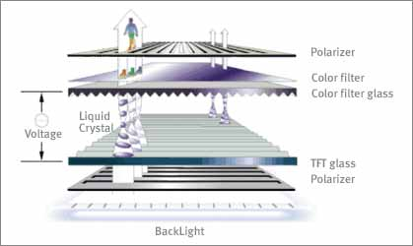
Liquid Crystal Display
Liquid crystal sandwiched between two transparent layers form images
Used for notebook computers, PDAs, cellular phones, and personal computers
Polarizer
Color filter
Color filter glass
Liquid Crystal
Glass polarizer
Backlight
Notes:
LCD monitors are made of two sheets of material filled with a liquid crystal solution. A fluorescent panel at the back of the LCD monitor generates light waves. When electric current passes through the liquid crystal solution, the crystals move around, either blocking the fluorescent light or letting the light shine through. This blocking or passing of light by the crystals causes images to be formed on the screen.
You’ll generally find two types of LCD monitors on the market: passive-matrix displays and active-matrix displays. Less expensive LCD monitors use passive-matrix displays, which use an electrical current to pass through the liquid crystal solution and charge groups of pixels.
With active-matrix displays, each pixel is charged individually. The result is a clearer, brighter image with better viewing angles.

Slide 29
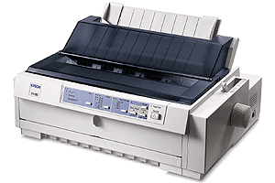




Printers
Impact printers
Dot-matrix
Non-impact printers
Inkjet
Laser
Multifunction
Specialty printers
Plotters
Thermal printers
Inkjet
Dot-matrix
Laser
Multifunction
Plotter
Thermal printer
Notes:
There are two primary categories of printers: impact and nonimpact.
Impact printers have tiny hammer-like keys that strike the paper through an inked ribbon, thus making a mark on the paper. The most common impact printer is the dot-matrix printer.
In contrast, non-impact printers don’t have mechanisms that strike the paper. Instead, they spray ink or use laser beams to transfer marks on the paper. The most common nonimpact printers are ink-jet printers and laser printers.
There are also a number of specialty printers on the market, including plotters and thermal printers.

Slide 30
Non-impact Printers
Ink Jet
Less expensive device
Full color printing
Slower in pages per minute (PPM)
More expensive per page in B&W
Laser
More expensive device
Black and White (Color lasers are very expensive)
Faster in PPM
Less expensive in B&W
Notes:
Ink-jet printers work by spraying tiny drops of ink onto paper. When using the right paper, higher-end ink-jet printers print images that look like professional-quality photos. Because of their high quality and low price, ink-jet printers are the most popular printer for color printing.
Laser printers are often preferred for their quick and quiet production and high-quality printouts. Because they print quickly, laser printers are often used in schools and offices where multiple computers share one printer. Although more expensive to buy than ink-jet printers, over the long run, for high volume printing, laser printers are more economical than ink-jets when you include the price of ink and special paper in the overall cost.

Slide 31
Choose Printers
Resolution
dpi: dots per inches
300 dpi for general purpose; 600x600
1200 dpi or above for images
Color output
Ink-jet: 4 or more colors
Memory
Use and cost
Notes:
Ink-jet printers work by spraying tiny drops of ink onto paper. When using the right paper, higher-end ink-jet printers print images that look like professional-quality photos. Because of their high quality and low price, ink-jet printers are the most popular printer for color printing.
Laser printers are often preferred for their quick and quiet production and high-quality printouts. Because they print quickly, laser printers are often used in schools and offices where multiple computers share one printer. Although more expensive to buy than ink-jet printers, over the long run, for high volume printing, laser printers are more economical than ink-jets when you include the price of ink and special paper in the overall cost.

Slide 32


Outputting Sound
Speakers and Headphones
Notes:
Most computers include inexpensive speakers as an output device for sound. These speakers are sufficient to play the standard audio clips you find on the Web and usually enable you to participate in teleconferencing.
If you plan to digitally edit audio files or are particular about how your music sounds, you may want to upgrade to a more sophisticated speaker system, such as one that includes subwoofers and surround-sound.

Slide 33

The System Unit
Box that contains the central electronic components of the computer:
CPU/RAM/ motherboard
Expansion cards
Power supply
Storage devices
Notes:
The system unit is the box that contains the central electronic components of the computer, including the computer’s processor, its memory, and the many circuit boards that help the computer function.
You’ll also find the power source and all the storage devices (CD/DVD drive, Zip drive, and hard drive) in the system unit.

Slide 34

The Front Panel
Drive Bays
Memory card reader
Floppy Drive
Productivity Ports
Power Button
Reset, standby
Warm/cold boot
Notes:
The front panel of your computer provides you with access to power controls as well as to the storage devices on your computer.
Your system has a power-on button on the front panel. (You may also find power-on buttons on some keyboards.)
Other features that can be seen on the front of your system unit are drive bays—special shelves reserved for storage devices.
Some PCs include memory card readers and productivity ports on the front including USB and FireWire, used for peripherals and image downloading.

Slide 35

The Back
Ports for peripheral devices
Types of ports:
Serial
Parallel
VGA
USB, firewire
Connectivity (modem, network)
Notes:
The ports on the back of the computer are mostly designed for long-term connections. The video port connects your monitor. Sound ports connect your speakers and microphone. Mouse and keyboard ports provide connecting points for these essential peripherals. Network and modem ports provide communications capability. USB ports allow connection to a wide array of devices.

Slide 36

Inside the System Unit
Essential electronic components used to process data
Types of components:
Power supply
Hard disk drive
Motherboard
CPU
Expansion cards
Notes:
The system unit contains the essential components of a computer. Inside is the power supply, motherboard, RAM, storage drives, expansion cards and the central processing unit. Today’s personal computer follows the same design concept of IBM’s first PC in 1981. All the components have evolved, but the foundation and concepts are the same.

Slide 37

The Motherboard
CPU
RAM
Expansion Cards
Chip Set
Built-in components
Notes:
The motherboard is the key circuit board holding the essential processing parts. Attached directly to the motherboard are the CPU, RAM, expansion cards and in many new computers, networking, modem, video, and audio components.

Slide 38

Central Processing Unit (CPU)
Referred to as the “brains” of the computer
Controls all functions of the computer
Processes all commands and instructions
Can perform billions of tasks per second
Notes:
The central processing unit (CPU, or processor) is the largest and most important chip in the computer.
It is sometimes referred to as the “brains” of the computer because it controls all the functions performed by the computer’s other components and processes all the commands issued to it by software instructions.
Modern CPUs can perform three billion tasks a second without error, making them extremely powerful components.

Slide 39
Memory Module
Random access memory (RAM)
Primary storage
Stores instructions and data
Temporary (volatile) storage
Operates in nanoseconds
Read only memory (ROM) – startup, time, BIOS
Notes:
Random access memory (RAM) is a series of small cards plugged into slots on the motherboard. The CPU can request any data in RAM It is then located, opened, and delivered to the CPU for processing in a few billionths of a second.
Because all the contents of RAM are erased when you turn off the computer, RAM is the temporary or volatile storage location for the computer.
To save data more permanently, you need to save it to the hard drive or to another permanent storage device such as a floppy disk, CD, or flash drive.

Slide 40

Expansion Cards
Adds functions
Provides new connections for peripheral devices
Common types:
Sound
Modem
Video (VGA)
Network (NIC)
Notes:
The various circuit boards connected to the motherboard have specific functions that augment the computer’s basic functions.
Some provide connections to other devices, so these are usually referred to as expansion cards. Typical expansion cards found in the system unit are the sound card and video card.
Other expansion cards provide a means for network and Internet connections such as the network interface card (NIC), which enables your computer to connect with other computers.

Slide 41
Hard Disk Drive
Stores data and program instructions
Permanent (nonvolatile) storage
Storage capacities up to 250 GB and higher
Transfers data in milliseconds
Notes:
The hard disk is permanently installed in one of the drive bays. It provides the essential permanent storage in the PC, holding the operating system, applications software ,and saved data. Modern hard drives hold enormous amounts of data and can retrieve it quickly.

Slide 42
Setting it all up: Ergonomics
Ergonomics refers to minimizing injury or discomfort while using the computer
Steps to follow:
Position monitor correctly
Use adjustable chair
Assume proper position while typing
Take breaks
Ensure adequate lighting
Notes:
Merriam-Webster’s Dictionary defines ergonomics as “an applied science concerned with designing and arranging things people use so that the people and things interact most efficiently and safely.”
In terms of computing, ergonomics refers to how you set up your computer and other equipment to minimize your risk of injury or discomfort
The following are some guidelines that can help you avoid discomfort, eyestrain, or injuries while you’re working at your computer:
-Position your monitor correctly---at least 25 inches from your eyes and at eye level or so that it is at an angle 20 to 50 degrees below your line of sight.
–Purchase an adjustable chair. Adjust the height of your chair so that your feet touch the floor and include back support.
–Assume a proper position while typing. Your wrists should be flat with respect to the keyboard and your forearms parallel to the floor. Specially designed ergonomic keyboards and wrist rests can help you achieve the proper position of your wrists.
–Take breaks from computer tasks.
–Ensure the lighting is adequate.

Slide 43
READ READ

